Slide 1
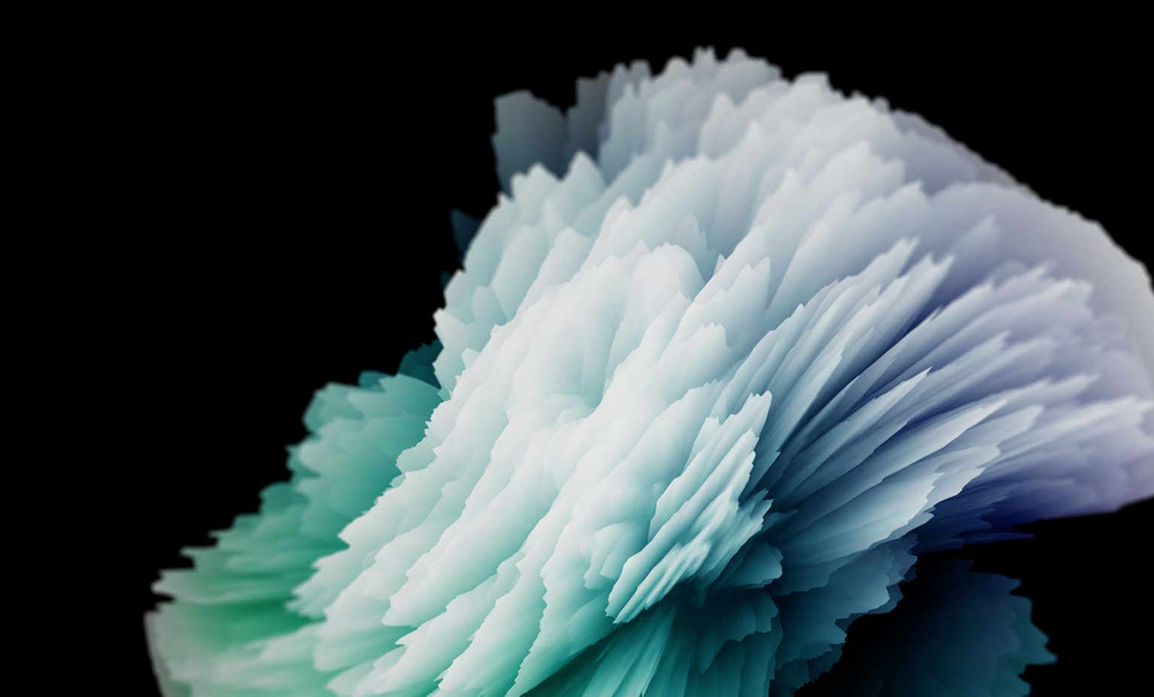
Animación 2D con Anima2D
Arturo Núñez
Field Engineer – Unity Technologies
@ArturoNereu
Notes:
Good evening, today we will talk about the future of 2D Animation in Unity. As you may have heard, we acquired and made free the Asset Store package: Anima2D. The ultimate goal solve the problem of animating 2D characters and objects in Unity in an efficient way.
Description for translators:
This presentation will focus on the 2D animation workflow we have right now in Unity, using the plugin called: “Anima2D”, we will also cover the differences between “Frame by Frame” animation and “Skeletal Animation”, the goal of this part is to know what are the pros and cons of each one.
I will also demo the setup for a 2D character using the Anima2D plugin, which will consist on opening Unity and setting up objects to create a “rig”, and “animations”.

Slide 2
Objetivos
Al final de esta presentación, serás capaz de:
Elegir la mejor técnica de animación para tu juego, basándote en restricciones técnicas y artísticas.
Animar un personaje humanoide en 2D utilizando Anima2D.
Enumerar las nuevas características de animación 2D de Unity.
Notes:
Here, we will mention the main objectives of attending the talk.

Slide 3
Animación
La Ilusión de Vida
Notes:
This slide is to define what the purpose of animation in games is. Which is simulate that the characters and other elements in the game are alive.
The animation is known also as the illusion of life, which basically transforms unanimated drawings or models into living characters. No matter which animation technique we end up using, the goal is to always have a consistent animation that makes the player he is inside the video game.
If for any reason, the animation fails (breaks, is not good enough, drops frames, etc) the player will feel disconnected from the game and will start thinking about it as a piece of software. We want to avoid that.

Slide 4
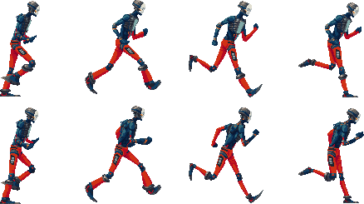
Animación ‘Frame by Frame’
Sprite Renderer
Notes:
We will start covering the technique called “Frame by Frame” animation, which has been around in the films and cartoons industry for quite some time. In this technique, we are basically flipping through the pages of a notebook. Where each page contains a part or frame of the animation with a small change with respect to the previous one.
In games, what we usually have, is a large texture called a Sprite Sheet, and what we do is to draw a frame of the texture during a period of time, then after x time passes, we switch to the other one and this gives the illusion of movement.

Slide 5
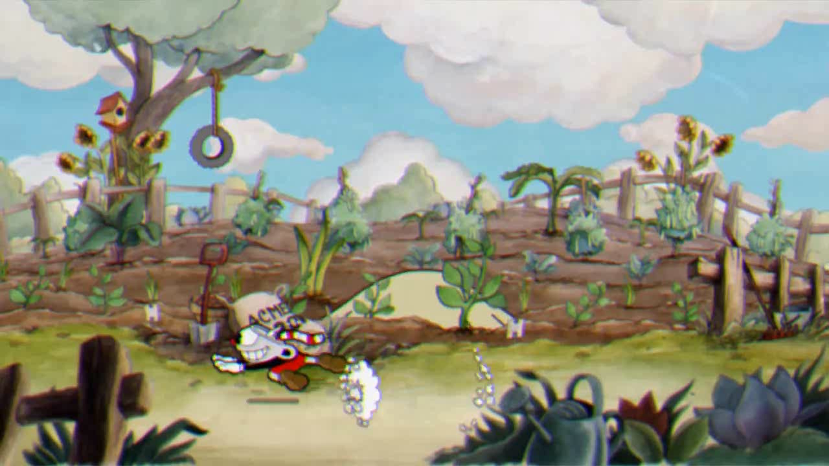
Notes:
This game is CUPHEAD by Studio MDHR, I will let the video run and after it finishes I will explain that the game is being drawn frame by frame. Which is the only way to achieve the aesthetics the developer wants, but it also takes more time since the process of drawing each frame and changing it needs to be manual.

Slide 6
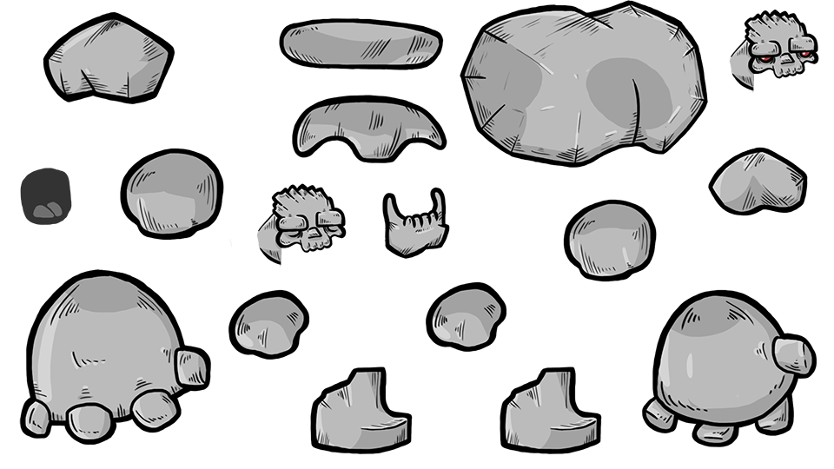
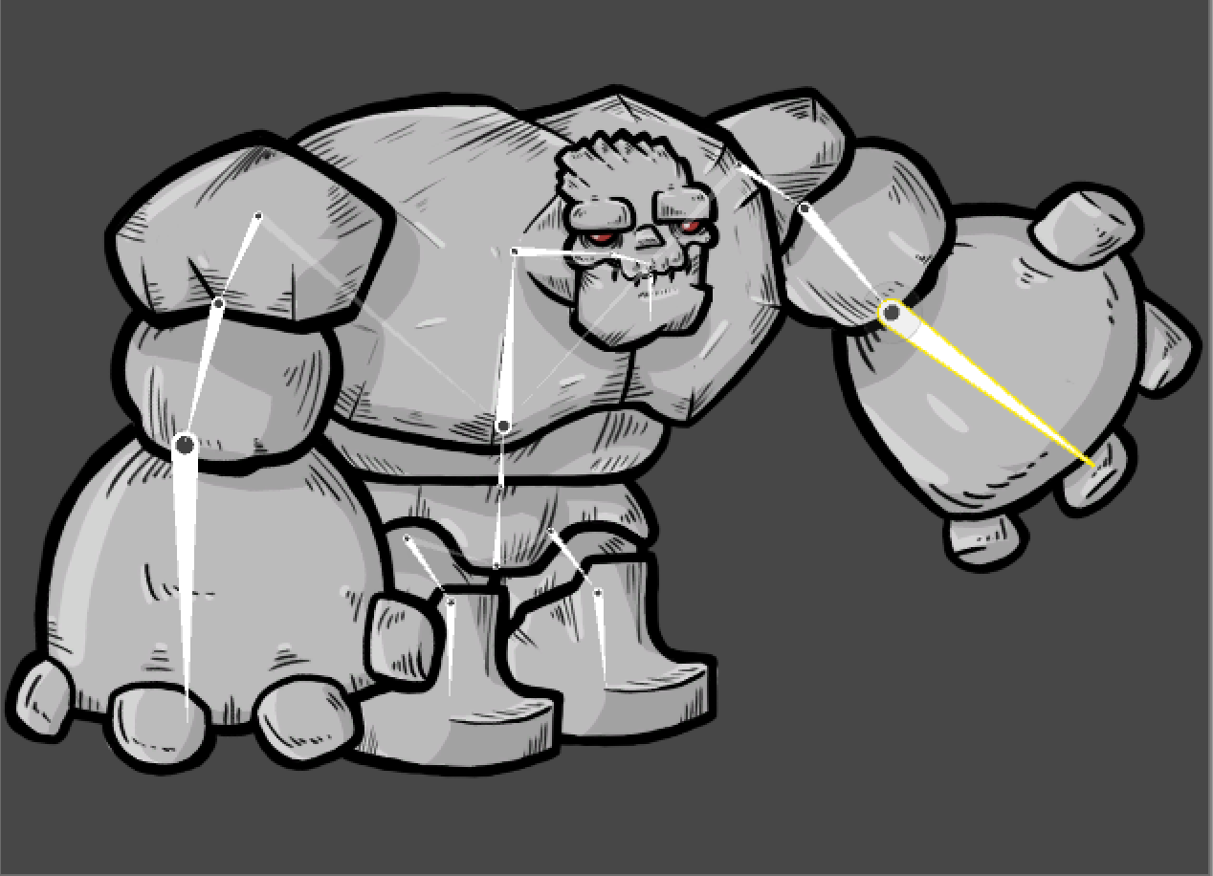
Animación ‘Skeletal Based’
Notes:
This is the other technique, called the skeletal based animation. It is called like this because we will create a skeleton for our characters, and the skeleton will be animated (with keyframes), thus, the images that are attached to those bones, will move when the bone moves accordingly.
As a quick note, this technique allows us to have a high number of animations without increasing the build size, which is important. However, the animation takes place on the CPU we need to consider this.
We will discuss more about this in a couple of minutes.

Slide 7
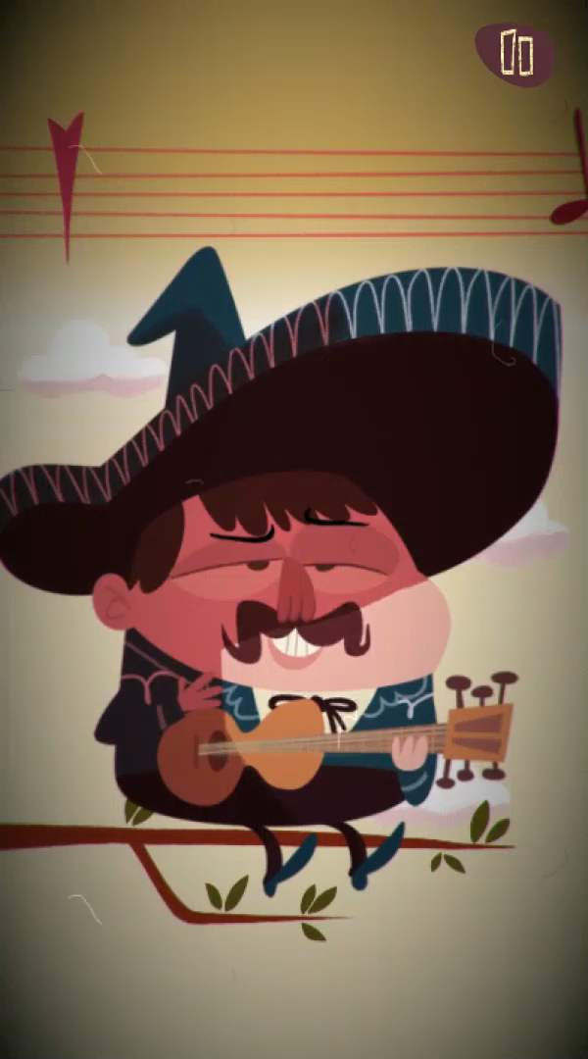
Notes:
Here, I will show a video from a Game that uses skeletal based Animation. Will just play it and then explain bits of how this could be achieved with the skeletal animation technique.

Slide 8
Frame by Frame | Skeletal
Texturas grandes, más memoria. | Atlas de imágenes simples, más CPU.
Cambios no tan flexibles. | Mayor flexibilidad a cambios.
Suavizado de animación require más frames. | El suavizado depende del tiempo y CPU.
No se puede hacer ‘blending’ de animación.* | Se puede hacer blending de animación.
Menor uso de CPU. | Muy Bueno para ahorrar memoria.
Animaciones más complejas y detalladas. | Animaciones más sencillas.*
Bueno para objetos pequeños. | Bueno para objetos grandes.
Notes:
Here, I will discuss advantages and disadvantages of one method over the other. The important thing to note is that no method is better than the other. It depends on what the developer wants to achieve and the resources constraints she may have.

Slide 9
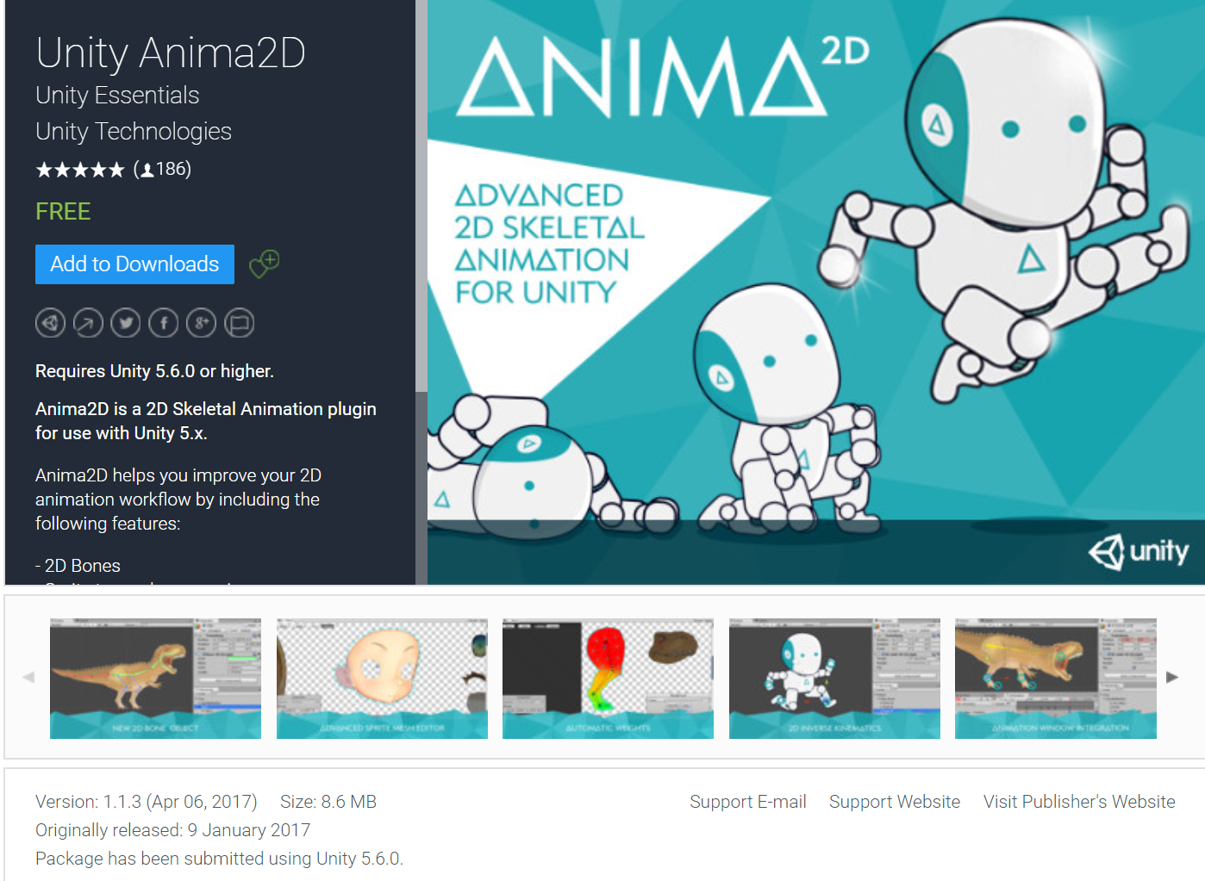
Anima2D
Plugin para animación esqueletal en Unity.
Gratis en la Asset Store.
Encaja en el flujo de trabajo de Unity.
Incluye código fuente en C#.

Slide 10
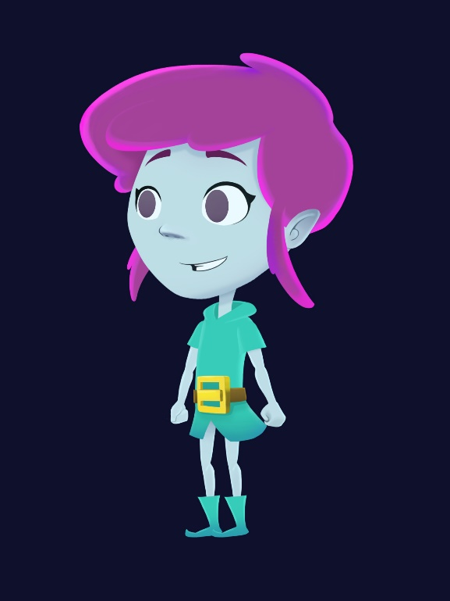
Demo Anima2D

Slide 11
¿Hacia dónde vamos?
El proceso de ‘rigging’ será incluido en el Sprite Editor. Con eso se logra un flujo de trabajo más rápido y limpio.
Crea y edita jerarquías de huesos completas.
Teselación manual y automática.
Asignación manual y automática de pesos en vertices.
Deformación de geometría.
Cinemática Inversa.

Slide 12
Referencias
Diapositivas y Proyecto:
https://github.com/ArturoNereu/Unity2DAnimation
Anima2D:
https://www.assetstore.unity3d.com/#!/content/79840
2D Skeletal Animation for Unity – Unite Europe
https://youtu.be/IQ8ZbZoXCcg

Slide 13


Slide 14
¡Gracias!

